Slide 1
Unit 4 :
Performing simple queries
Session 2
Databases
1

Slide 2
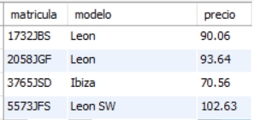
The SELECT statement. Selection consultations
When we talk about selecting rows within a query we are referring to obtaining the rows that meet a certain condition. To select rows in a SELECT query, the WHERE clause is used.
Within the WHERE clause an expression will be used that returns a boolean value. The rows that return the value true in that expression are selected .
Example: Obtain the license plate, model and price of all available SEAT brand cars.
SELECT license plate, model, price FROM cars WHERE brand='seat';
2

Slide 3
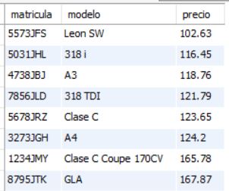
The SELECT statement. Selection consultations
Example: Obtain the make, model and rental price of all cars with a rental price per day greater than or equal to €100, sorted by price ascending.
SELECT make,model,price FROM cars WHERE price>=100 ORDER BY price;
3

Slide 4
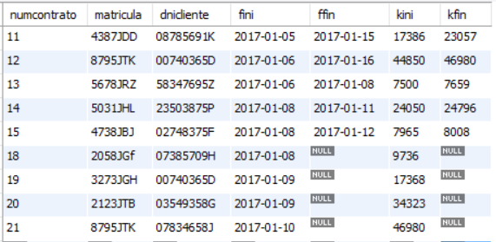
The SELECT statement. Selection consultations
Example: Obtain all the data of the contracts carried out in 2017.
SELECT * FROM contracts WHERE fini>'2016-12-31';
SELECT * FROM contracts WHERE year(fini)=2017;
4

Slide 5
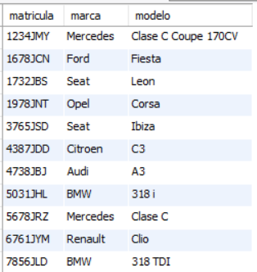
The SELECT statement. Selection consultations
Example: Obtain the license plate, make and model of all cars listed as available for rent (not rented).
SELECT license plate, make, model FROM cars WHERE rented!=true;
SELECT license plate, make, model FROM cars WHERE rented=false;
5

Slide 6

The SELECT statement. Selection consultations
Example: Obtain the first and last name of all clients named Alicia.
SELECT firstname,lastname FROM customers WHERE name='alicia';
6

Slide 7
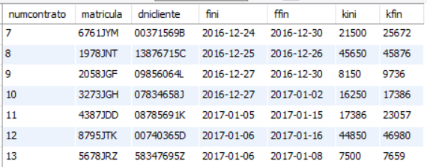
The SELECT statement. Selection consultations
SELECT WITH BETWEEN
The BETWEEN clause is an operator that allows find out if a value is within an interval . It is used with the syntax :
BETWEEN value lower AND higher
Example : Get the everyone 's data the contracts carried out between December 24 , 2016 and January 6 , 2017 (both included ).
SELECT * FROM contracts WHERE fini BETWEEN '2016-12-24' AND'2017-01-06';
7

Slide 8
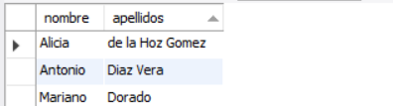
The SELECT statement. Selection consultations
SELECT WITH BETWEEN
Example: Obtain the first and last names of all customers whose first last name begins with the letter 'D'.
SELECT firstname,lastname FROM customers WHERE lastname BETWEEN 'D' AND 'E';
8

Slide 9
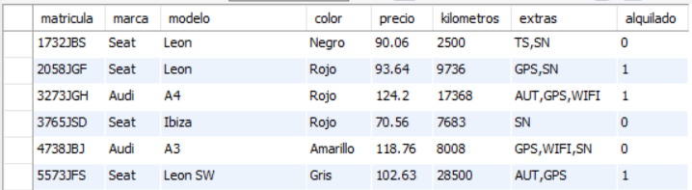
The SELECT statement. Selection consultations
SELECT WITH IN
The IN clause is an operator that allows you to check whether or not the value of an expression matches one of a set of values. The set of values is expressed in parentheses, separating the values with a comma. The syntax to use IN is:
IN expression (value1, value2, value3, ….,valueN)
Example: Obtain all data on SEAT, AUDI, HYUNDAI or TOYOTA brand cars.
SELECT * FROM cars WHERE brand IN ('seat','audi','hyundai','toyota');
9

